Slide 1
Summer Mentorship Program IITK-2022
Group Members:
Srijani Adhikary
Sahil Mallick
Mentor: Shubhadeep Das(Senior Analyst at HSBC)

Slide 2
Healthcare Provider Fraud Detection

Slide 3
Objective: Build a model to predict the potentially fraudulent providers based on the claims filed by them in the field of healthcare.

Slide 4
Data Description
Inpatient Data
Provides insights about the claims filed for those patients who are admitted in the hospitals.
Contains 40474 rows and 30 columns.
Outpatient Data
This data provides details about the claims filed for those patients who visit hospitals and not admitted in it.
contains 517737 rows and 27 columns.
Beneficiary Details Data
This data contains beneficiary KYC details like health conditions, region they belong to etc.
Contains 138556 rows and 25 columns.
Provider Data
Gives the value 1 or 0 against each provider depending on whether the Provider is fraud or not.
Contains 5410 rows and 2 columns.

Slide 5
Data Preparation
Inpatient Data
df_in
from in, out and beneficiary data
Merged Data
Outpatient Data
df_out
Merge all data to get final data
Final Data
(at provider level))
Beneficiary Data
df_merged
Provider Data

Slide 6
Development and Validation Sample
Data
Observations:5410
Development Sample
Observations: 5004
(for model building)
Validation Sample
Observations: 406
(for model scoring)

Slide 7
Feature Engineering
WOE features are created using weight of evidence method.
Binary flag variables are created from the insights derived in EDA.
E.g. – Created a feature ‘derived_ChronicCond_Cancer_flag’ takes the value 1 if total instances of Cancer disease under that Provider is >= 70 etc.
Some of the WOE features are dropped as they were highly correlated.

Slide 8
Feature Selection
We fitted Decision Tree, Random Forest and CatBoost Classifier to the development sample and obtained the quantitative values of importance of the features.
By weight of evidence method we obtained the information value for each feature.
Using Recursive Feature Elimination technique we ranked the features.
Comparing all the 5 methods we selected 35 features out of which 2 are derived flag variables and the rest are the features created by woe method.

Slide 9
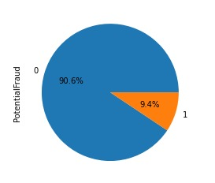
Train-Test Split
As the development sample is imbalanced with respect to potential fraud we split into train and test parts by stratification.
.
Development sample
Observations:5004
Train
Observations:4003
Test
Observations:1001

Slide 10
Model Building
We applied logistic regression, decision tree classifier, random forest classifier, lightgbm classifier and xgboost classifier to the train part of development sample.
We performed hyperparameter tuning of those models to reduce over-fitting with the help of bias-variance trade off.
We choose the model with highest precision whose other performance measures are also high.

Slide 11
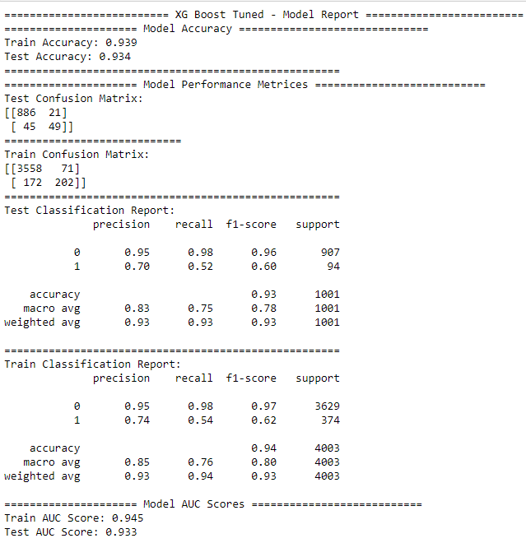
Here we chose xgboost as our best model whose performance measures are given below:

Slide 12
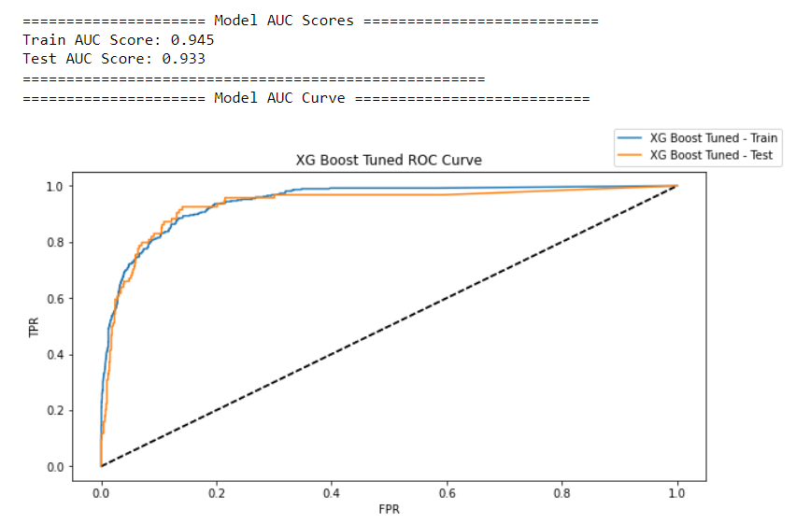
The ROC curve for the tuned xgboost model is as follows :

Slide 13
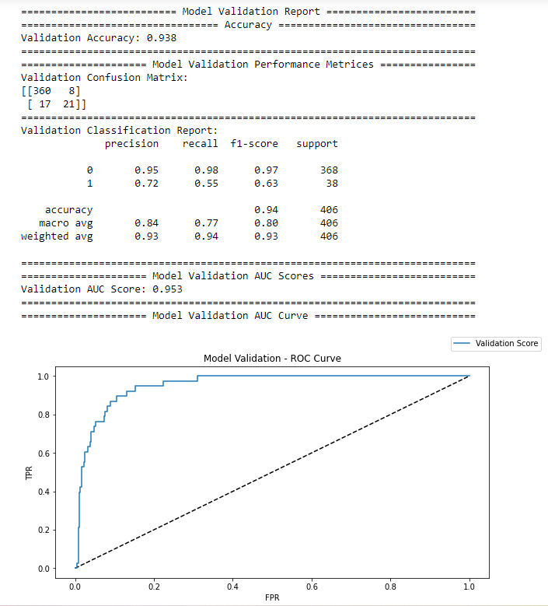
Scoring The Model On Validation Sample
Now on validation sample we created the features that were finally selected for model development in similar way. Then we scored the final xgboost model on this data and got the following result :

Slide 14
Important Features
We can conclude based on our observation that, while detecting fraudulent providers in the field of healthcare one should always keep in mind some key factors:
insurance claim amount reimbursed
age of the beneficiaries
instances of various diseases
physician in charge etc.

Slide 15
App
After building the model an interactive app was created where the insurance company can enter the details and find out if the provider is fraudulent or not.
App Link : https://healthcare-provider-fraud.herokuapp.com/

Slide 16
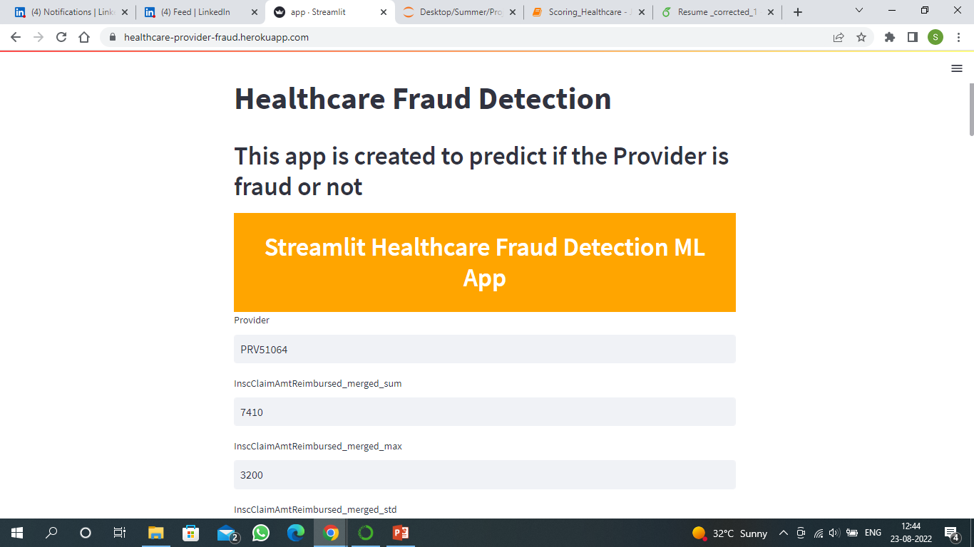
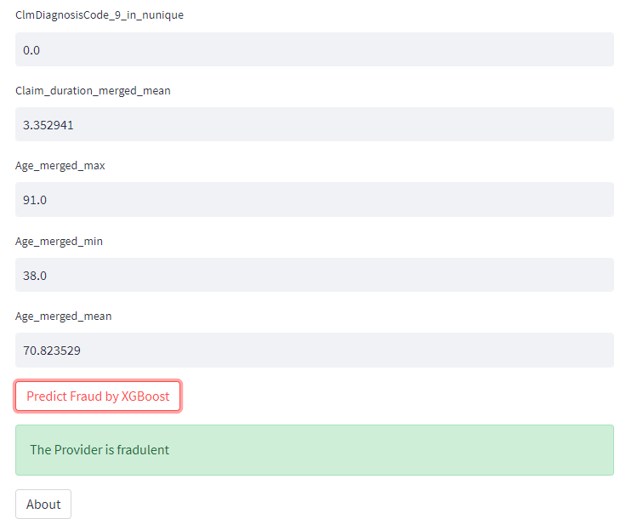
A Screenshot is attached to show how the app works.

Slide 17
Conclusion
The precision of our final model on unseen data comes out to be 0.72 which means the probability of identifying fraudulent providers correctly is 0.72 which is satisfactory for our purpose.
The model accuracy and AUC are 0.938 and 0.953 respectively which are quite high.
We can conclude that our model performs well on the validation sample and we can use this model for further fraud detection in thus field.

Slide 18
Thank You

